Slide 1
Business Process Engineering
Sobia Iftikhar

Slide 2
Content
Business Canvas Model
Lean Canvas Model
Business Process Architecture
Business Process Architecture Design Approaches.
Goal Based, Action Based,
Object Based, Function Based
Reference Model Based)
Benefits of Process Based Business Architecture

Slide 3
Business Canvas Model
Business Model Canvas is a basic tool for defining the way of the functioning of a business.
It is a simplified model of a business plan, which is used to verify the quality delivered to clients based on the market conditions.
The model enables you to logically examine the relationships within your activity, take a close look at your own proposition and judge it rationally.
Business Model Canvas is also a kind of a test – is your business matched with the clients’ needs, and is your proposition profitable.

Slide 4
9 Business Canvases Important From The Perspective Of Running A Business:
Value proposition:
it’s good to know why a client chooses your company over another?
what becomes their key motivation?
which need you fulfill?
what elements of your business are vital to them?
what it is that you stand out and what value you generate for them.
Segmentation of clients:
The basic question that you need to ask yourself is: who are my clients?
Segmental questions of demographic and behavioral (shopping behaviors of the user) character may come in handy.
At this stage, you normally characterize your client in a general way, focusing on their one most dominant characteristics, e.g. their profession.

Slide 5
9 Business Canvases Important From The Perspective Of Running A Business:
Relations with clients: you’ll communicate differently with a business client (B2B), and differently with the end-user (B2C).
Revenue streams: What are customers willing to pay and how? This is part of all canvases.
Key resources: What resources (time, money, resources) am I using to create this value?
Key activities: What should we do to deliver, what crucial activities should be done to create value?
Key partners: Which partnerships are necessary / can be developed in order to create value? Also part of the Strategy Sketch.
Cost structure: What are the costs resulting from this addition? Are these fixed, recurring costs? What are the variable costs? And what are the one-off costs?

Slide 6
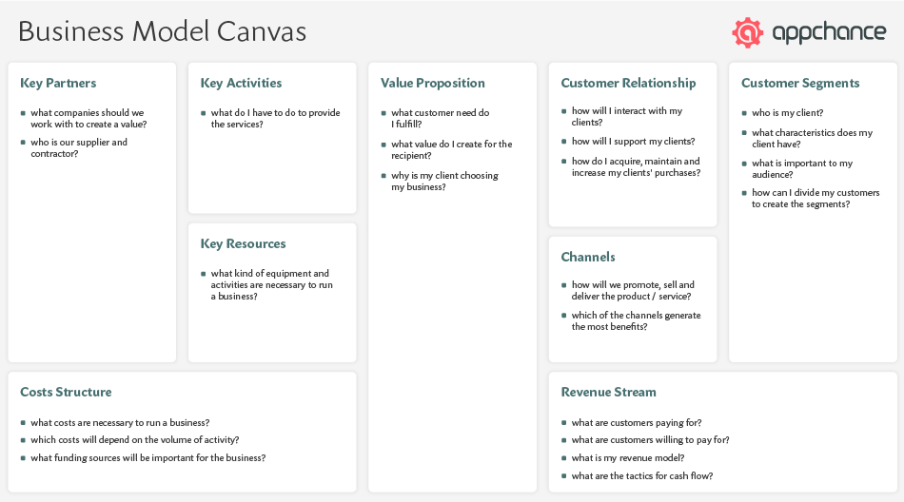
Business Model Canvas consist of

Slide 7
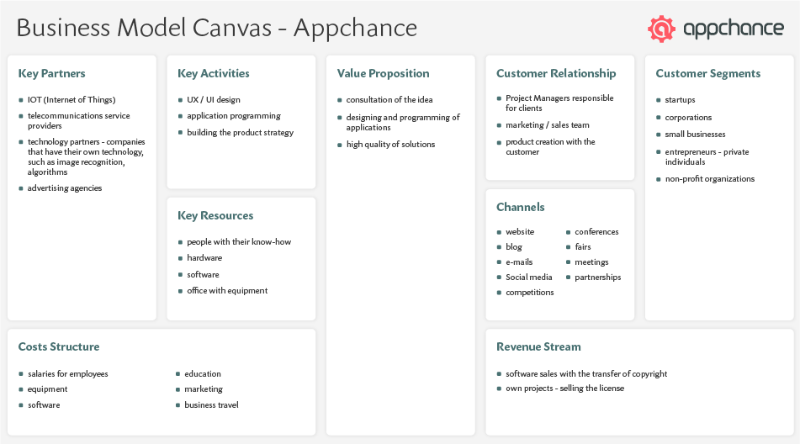
Example
Example of Business Model Canvas (BMC) for mobile and web software development

Slide 8
Example

Slide 9
Lean Canvas Model
It is estimated that 90% startups in Silicon Valley fail. CB Insights did a study on 101 startups, analyzing 20 main reasons for their failure. The biggest mistake was the mismatch between the solution to the market need. Moreover, in the first ten, apart from the issues with financing, the following things also appeared: wrong team member selection, competitors, weak product, business model and marketing. All these elements are part of a bit complex question, which is strategic management of a company. That’s why after the initial sketching of the business activity and checking the logic behind the relations, you need to enhance this basic sketch with a more in-depth analysis. Lean Canvas is a starting point for startups which helps you validate your idea.

Slide 10
4 aspects that make Lean Canvas different than Business Model Canvas
Problem
Solution
Measurements
Unfair Competition

Slide 11
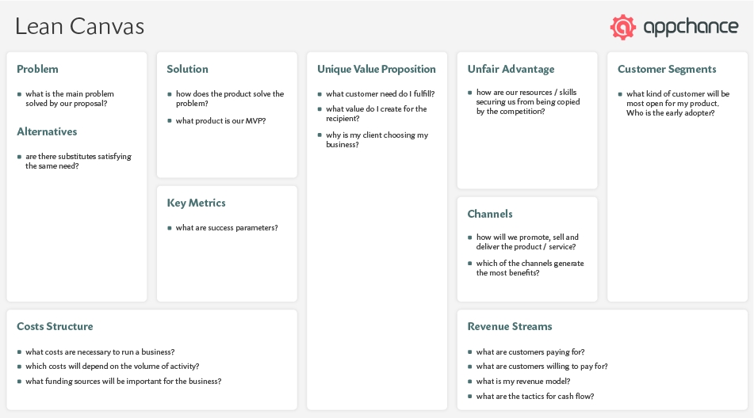
Lean Canvas
This canvas enables entrepreneurs and startups to quickly validate their business idea following the principles of lean startup.

Slide 12
9-Factors
Customer segments: This canvas is mainly focused on completely new propositions and startups. If you come up with a new proposition, it is useful to know where you can find the so-called early adopters. This group is part of the final, larger customer segment. We find this element in all canvases, but here it is a bit more specific.
Problem: The focus in Lean Startup and this canvas is on solving problems that are really worthwhile. Here you describe the top 3 problems that the customer has to deal with and that you want to solve.
Solution: This is how you want to deliver value. The solution is often what we all get excited about and work hard for. It is deliberately a small box that should only be filled in after the customer segments and their problems are known. With the other canvases, the solution falls under value proposition.
Value proposition: The convincing plan or offer that solves the customer's problems. This element is part of all canvases.
Revenue streams: The revenue model and pricing is part of the business model. This element is reflected in all canvases.
Channels: Which channels do you use to get to the customer and reach them? To be compared with customer relations and channels from the Business Model Canvas.
Measuring success: How are you going to measure whether you are successful? Which customer actions have value for you? This does not always have to be a financial metric. Determining the right metrics is important to make sure you don't make decisions based on irrelevant data.
Costs: What are your fixed and variable costs and how do they compare to the standards you have set? Part of all canvases.
Unfair advantage: What does your organization have to offer that cannot easily be copied by others? How do you arm yourself against competition? This part is also included in the Strategy outline among competitors.

Slide 13
Example
Google
Year of foundation: 1998
Venue: Menlo Park, CA
Original name: Googol
Founded by: Larry Page and Sergey Brin
Total funding amount: $36.1 million (last funding in 2000)
IPO: raised $1.7 billion in 2004

Slide 14
In terms of popularity and global adoption, Google is an undisputed number one company. What originated as an advanced web search engine has grown into a multinational giant that specializes in online advertising, cloud computing, hard and soft products, and many others. It’s hard to believe, but Google’s bootstrapping began in a garage, where two Montessori minds implemented their knowledge obtained in the Stanford University more than 20 years ago.
Sergey Brin and Larry Page saw gaps in Excite or Yahoo – search tools of those days and strived to improve upon their idea – to create a reliable, comprehensive and speedy search engine. The synergy of their collaboration resulted in the PageRank algorithm, which was based on the Page’s project nicknamed BackRub. According to modern realia, PageRank was the startup’s unfair advantage. Google’s founders made attempts to sell the technology to their potential competitors but failed. So, they changed the direction towards developing their research project into the lean startup. Fortunately, the co-founder of Sun Microsystems, Andy Bechtolsheim, saw some potential in their work and invested $100K. In 2018, the market value of Google exceeded $700 billion.

Slide 15
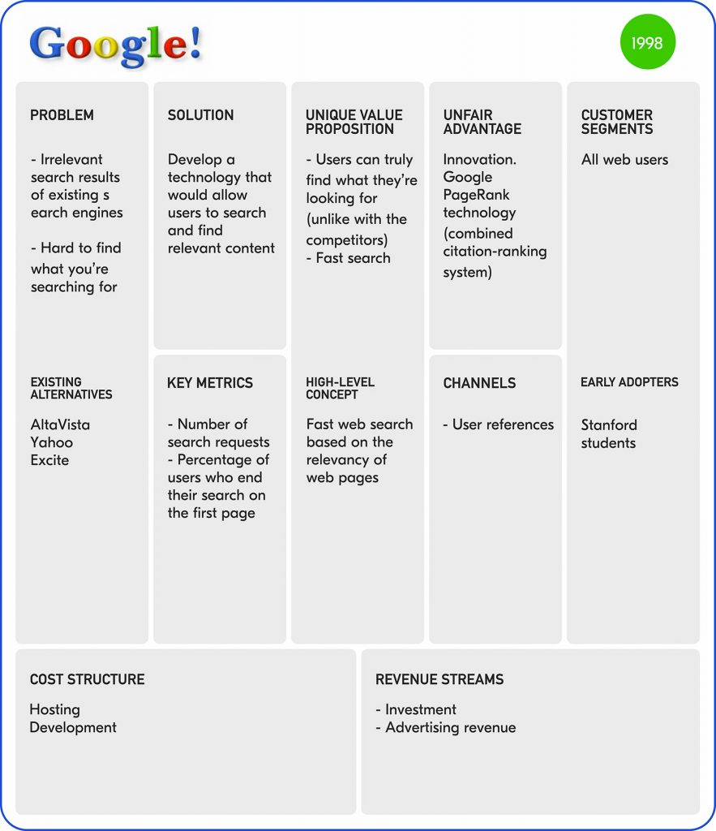
Lean Canvas

Slide 16
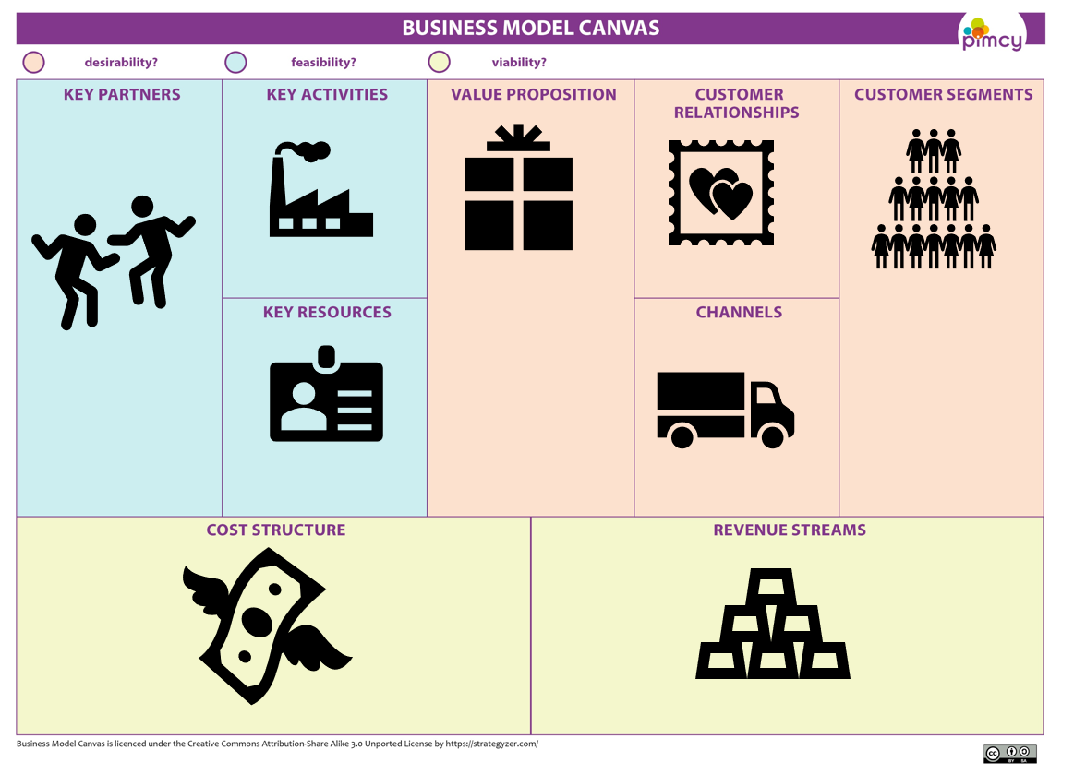
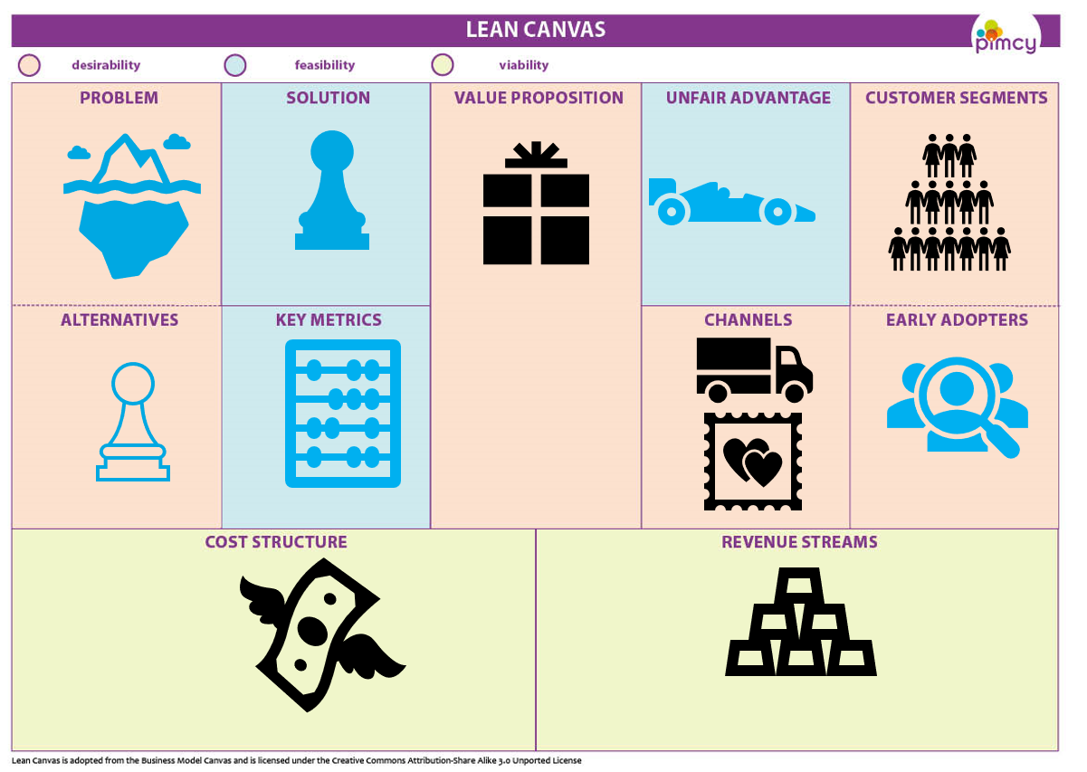
Difference

Slide 17
Sure. Here is an example of a complete scenario-based question and its mapping to the Lean Canvas and the Business Model Canvas:
Scenario:
You are a startup founder who is developing a new type of software that helps people manage their finances. You have a great idea for the software, but you are not sure how to make money from it.
Lean Canvas:
Problem: People are struggling to manage their finances.
Customer: People who are trying to save money, pay off debt, or invest for the future.
Solution: A software that helps people track their spending, set budgets, and reach their financial goals.
Value Proposition: The software is easy to use and provides a comprehensive overview of a person's finances.
Channels: The software will be available online and through mobile apps.
Customer Segments: The target customers are people of all ages and income levels who are interested in managing their finances better.
Key Resources: The key resources are the software development team, the marketing team, and the sales team.
Key Activities: The key activities are developing the software, marketing the software, and selling the software.
Key Partnerships: The key partnerships are with banks, credit card companies, and financial advisors.
Revenue Streams: The revenue streams are subscription fees, advertising fees, and transaction fees.

Slide 18
Business Model Canvas:
Customer Segments: People who are trying to save money, pay off debt, or invest for the future.
Value Proposition: A software that helps people track their spending, set budgets, and reach their financial goals.
Channels: Online and mobile apps.
Customer Relationships: Direct relationships with customers.
Revenue Streams: Subscription fees, advertising fees, and transaction fees.
Key Resources: Software development team, marketing team, sales team.
Key Activities: Developing the software, marketing the software, and selling the software.
Key Partnerships: Banks, credit card companies, and financial advisors.
Cost Structure: Development costs, marketing costs, sales costs, and operational costs.
By using both the Lean Canvas and the Business Model Canvas, you can get a more complete picture of your business model and make sure that it is aligned with your startup's goals. This will help you to build a successful business.

